Slide 1
Introduction to Hardware and IoT
University of Pittsburgh

Slide 2
What is IoT
what is the “internet of things”
Notes:
People always ask “what is I O T”- IOT stands for Internet of things, so now we wanna know, what is the internet of things?

Slide 3
What is IoT
Internet of things
Syllabification (Inter•net of things) noun
A proposed development of the Internet in which everyday objects have network connectivity, allowing them to send and receive data: “If one thing can prevent the Internet of things from transforming the way we live and work, it will be a breakdown in security.”
Source: Oxford Dictionary, yep, it’s really in the Oxford Dictionary. It got added mid 2013

Slide 4
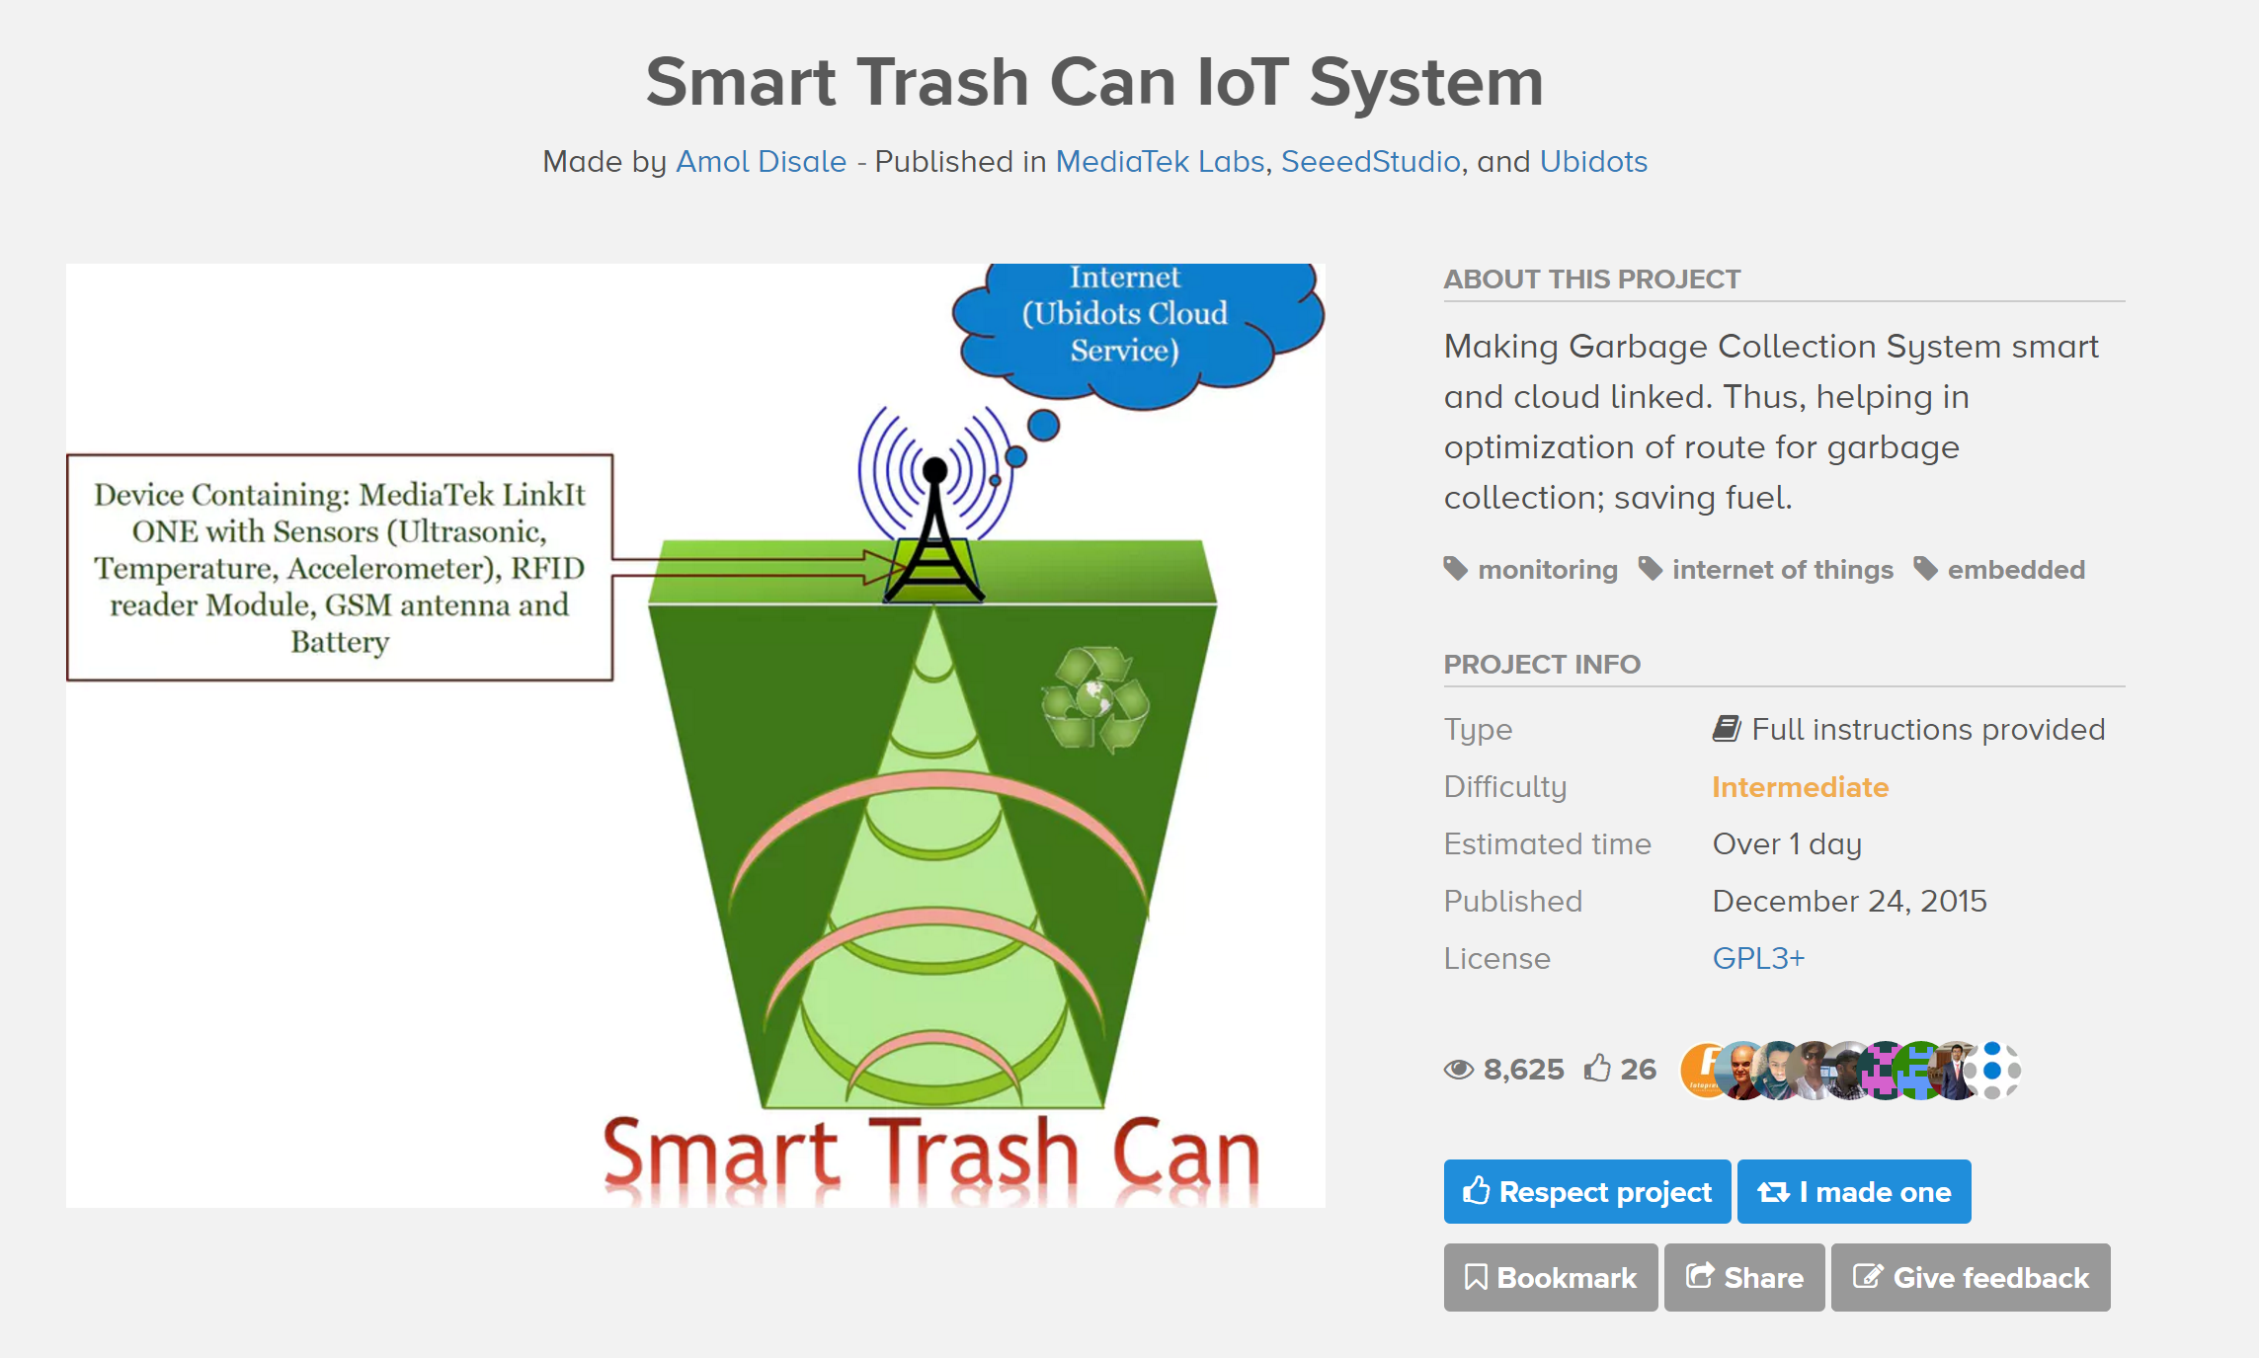
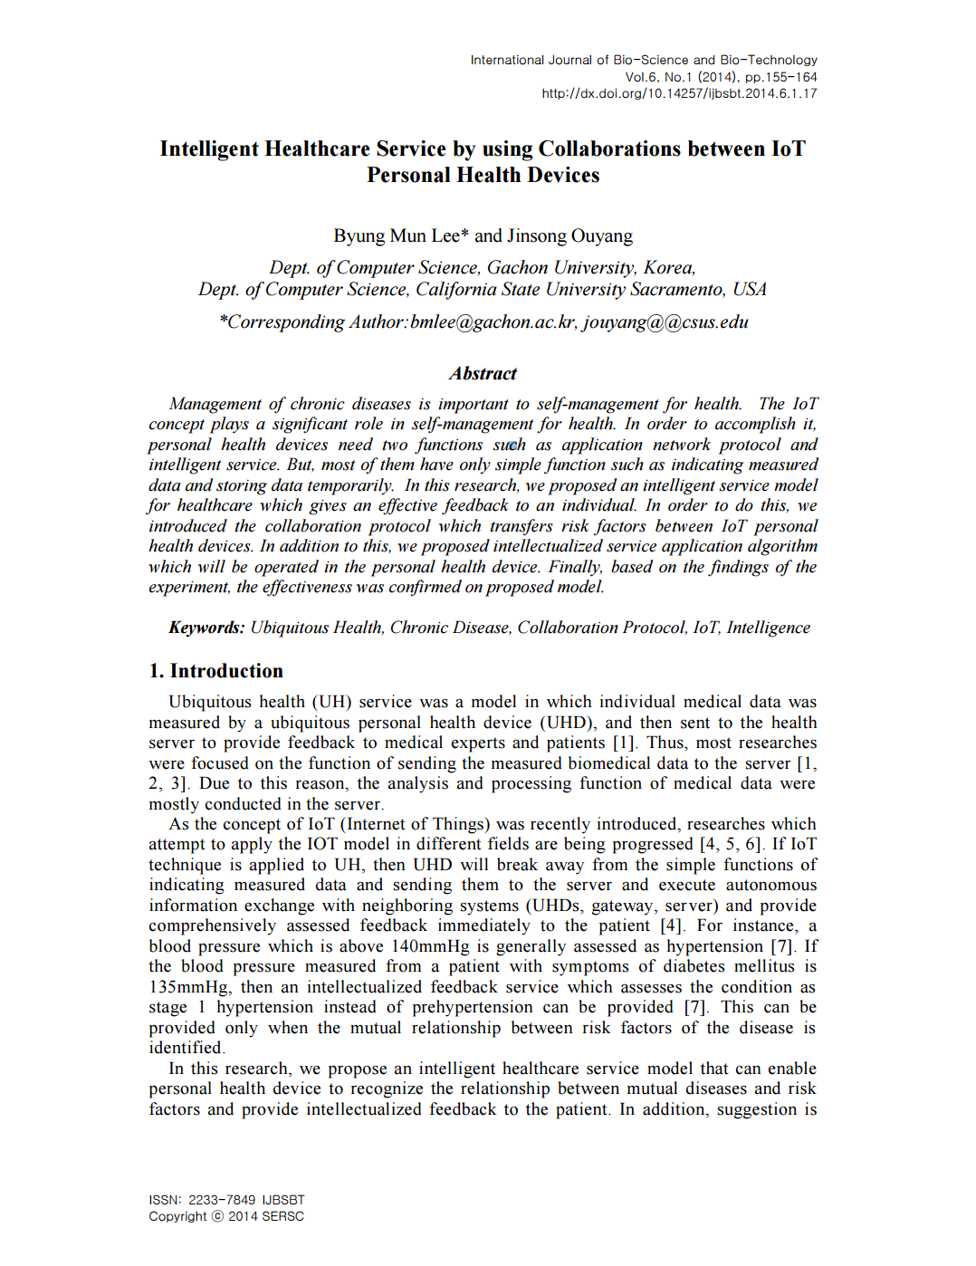
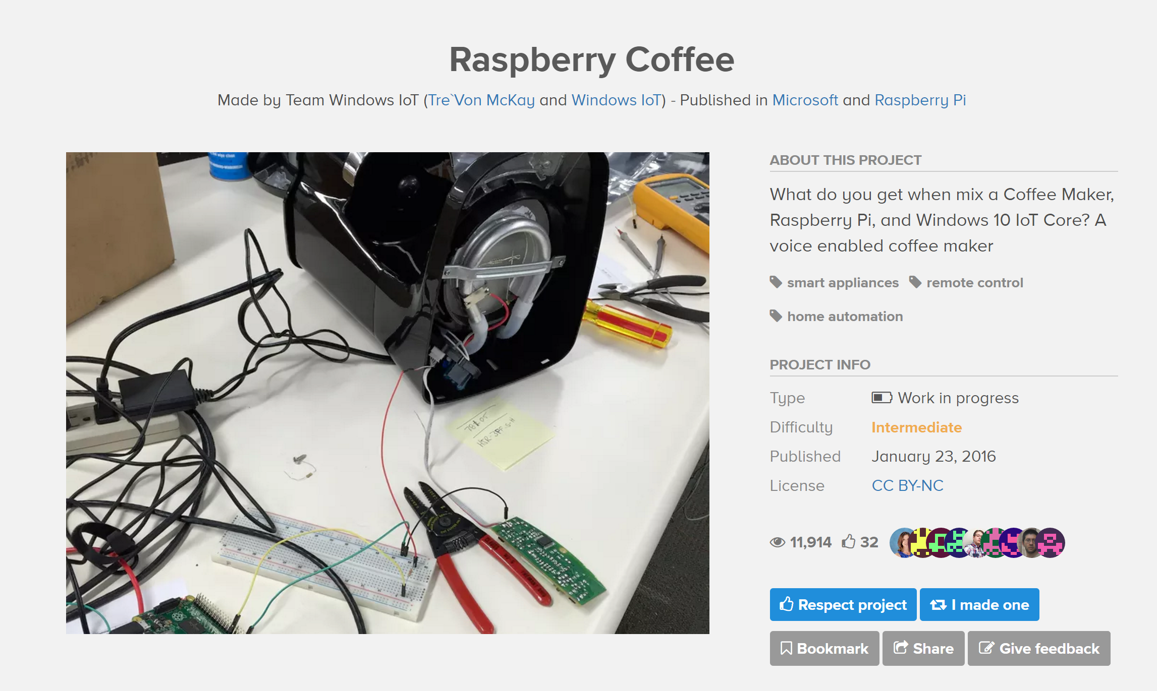
~nifty~ IoT Projects
Notes:
You can do silly stuff like making your trash can smart, connecting your coffee machine to your smartphone, or even serious stuff like developing a

Slide 5
What is IoT
how do we build IoT projects
Notes:
Knowing that, the question then becomes “”, and the answer is

Slide 6
What is Hardware
Hardware
Syllabification (hard•ware) noun
The machines, wiring, and other physical components of a computer or other electronic system.
‘select a software package that suits your requirements and buy the hardware to run it on’
Source: Oxford Dictionary, also the Oxford Dictionary
Notes:
Typically refers to microcontroller, allows you to do some kind of data processing, connect to the web, and communicate valuable information

Slide 7
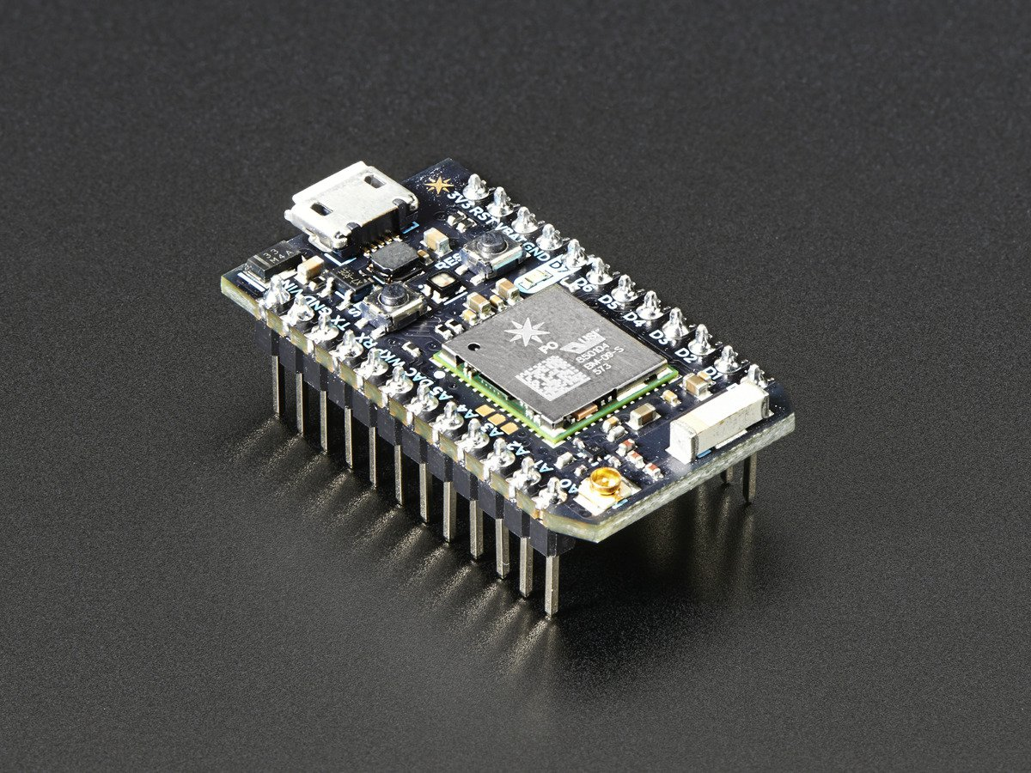
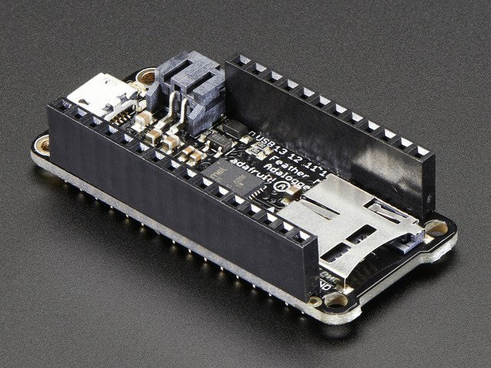
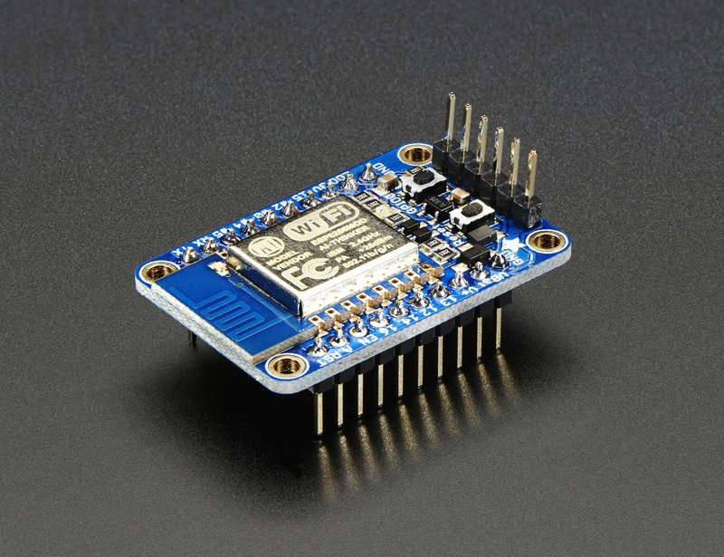
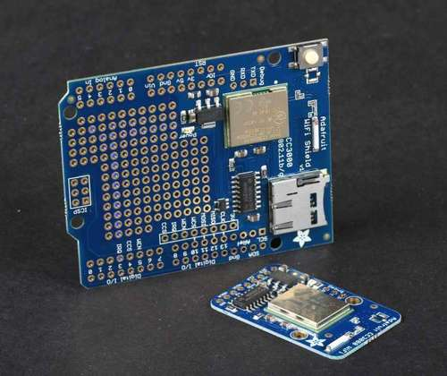
Boards, Modules, Shields
Microcontroller
Microcontroller
Wi-Fi Module
Module or Shield
Particle
Photon
Adafruit
Feather M0
Espressif
ESP8266
Adafruit
CC3000
Notes:
Amateur/hobby electronics

Slide 8
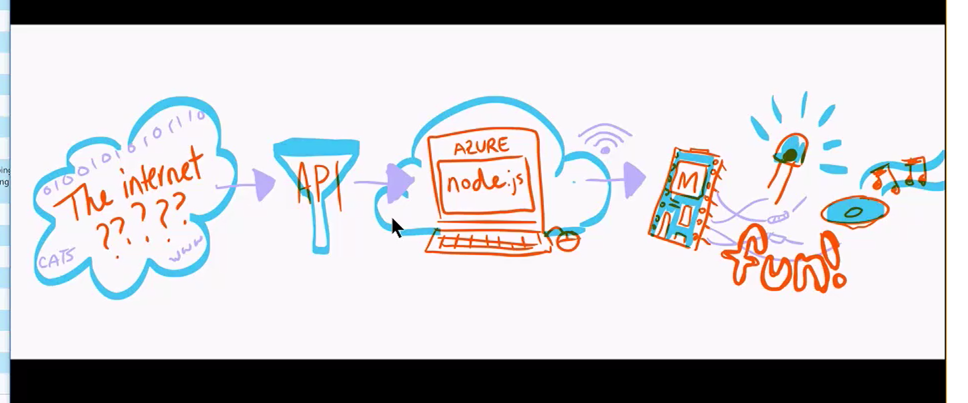
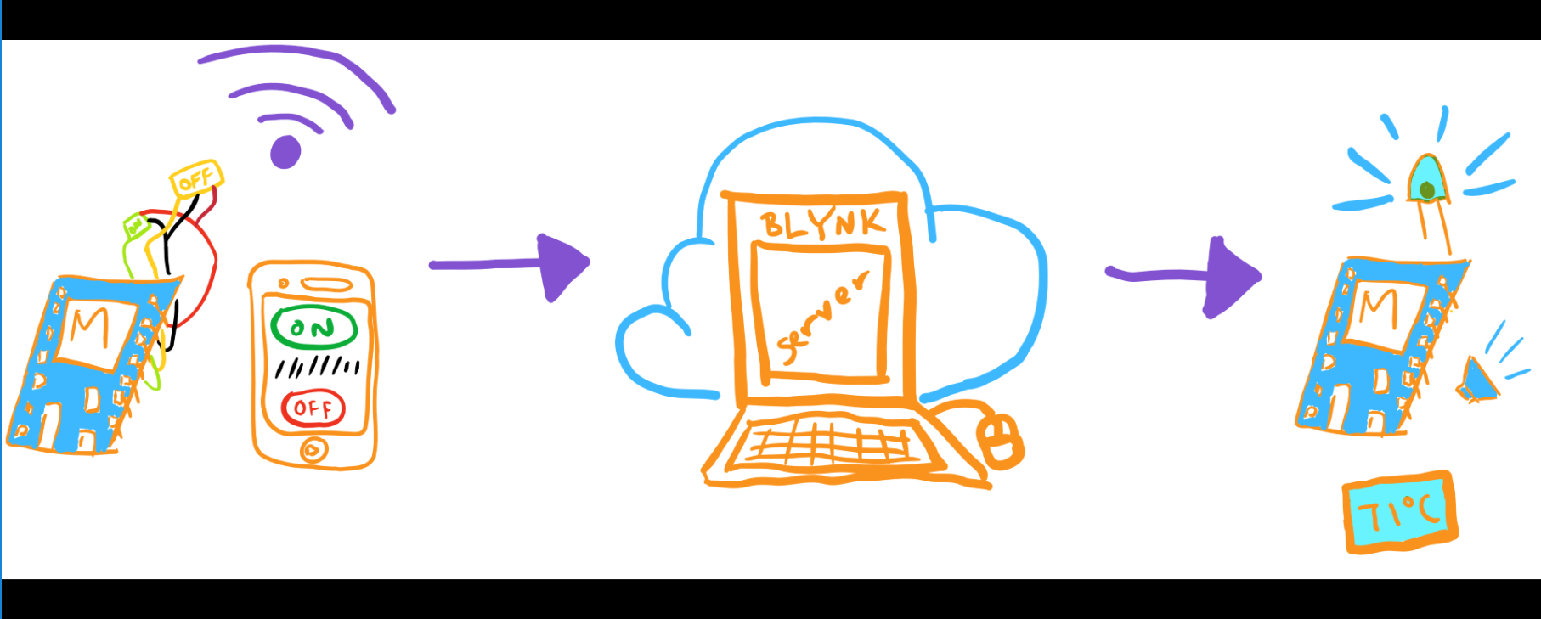
The general idea
Active Control
Passive Data Acquisition
Notes:
Top left image credit: Rachel Weill, Microsoft TE

Slide 9
Breaking it down
Hardware
(code, microcontrollers)
Cloud server (data processing, comms)
API
free [big] data
Hardware
(breadboard, components)

Slide 10
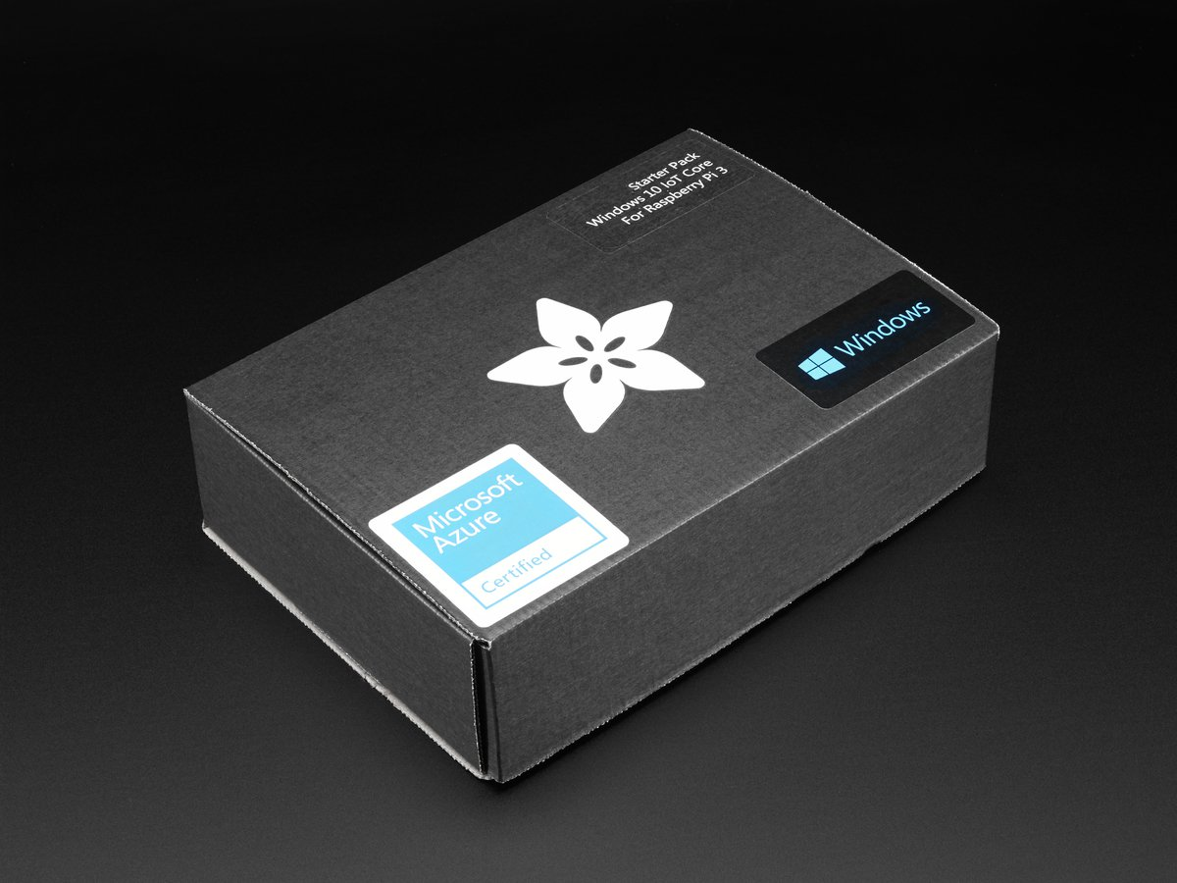
Hands on with Hardware
What are we doing?
Using the Microsoft Azure IoT Starter kits to learn the basics of working with microcontrollers, inputs and outputs.
Notes:
Layered io system across different levels

Slide 11
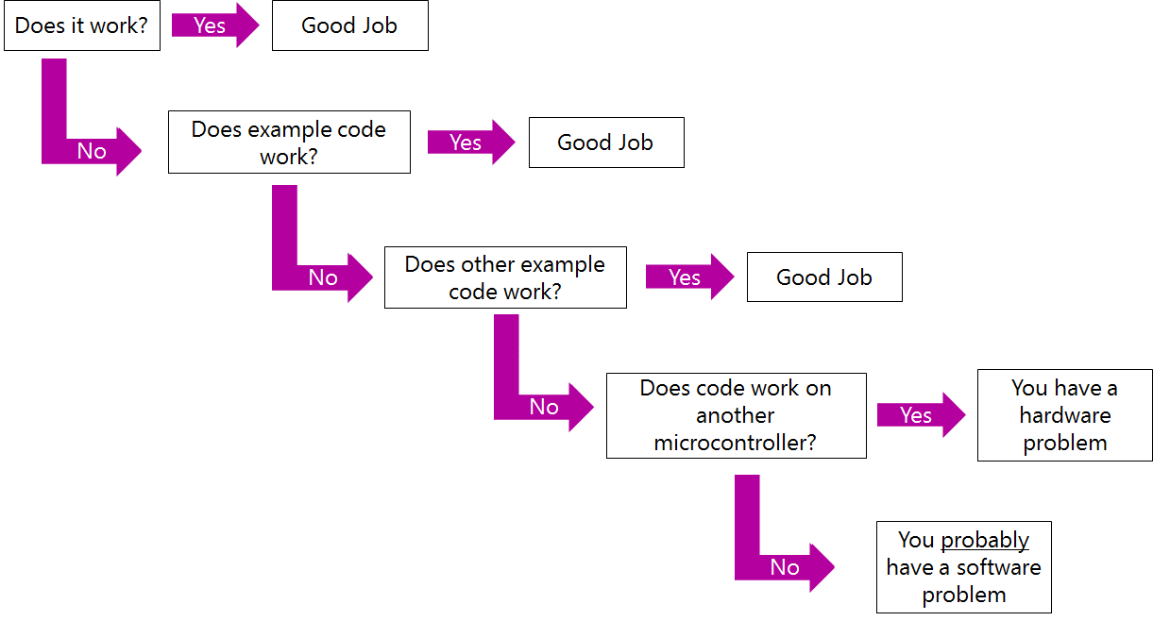
The Hierarchy of Debugging
Notes:
One of the biggest things people struggle with is getting their stuff to work, and it’s really not that difficult if you have a general idea of how to approach things
So here’s basically everything you need to know about debugging hardware stuff (microcontrollers)

Slide 12
Breaking it down
Hardware
(code, microcontrollers)
Cloud server (data processing, comms)
API
free [big] data
Hardware
(breadboard, components)
Notes:
So going back to a few slides ago, this is the hardware part of IoT system design

Slide 13
Hardware
What are we doing?
Using the Microsoft Azure IoT Starter kits to learn the basics of working with microcontrollers, inputs and outputs.

Slide 14
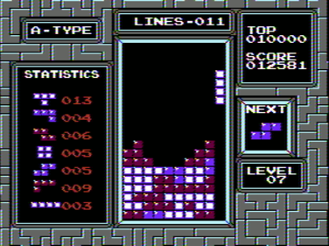
Tetris!!!
But actually?

Slide 15
Hardware
What do I get out of this?
Working with a new type of microcontroller
Getting familiar with installing board support and new libraries
Experiencing GitHub and exploring the internet for fun projects
Play Tetris
Notes:
Last boring slide, I promise
So without giving too much away, what’s the point?

Slide 16
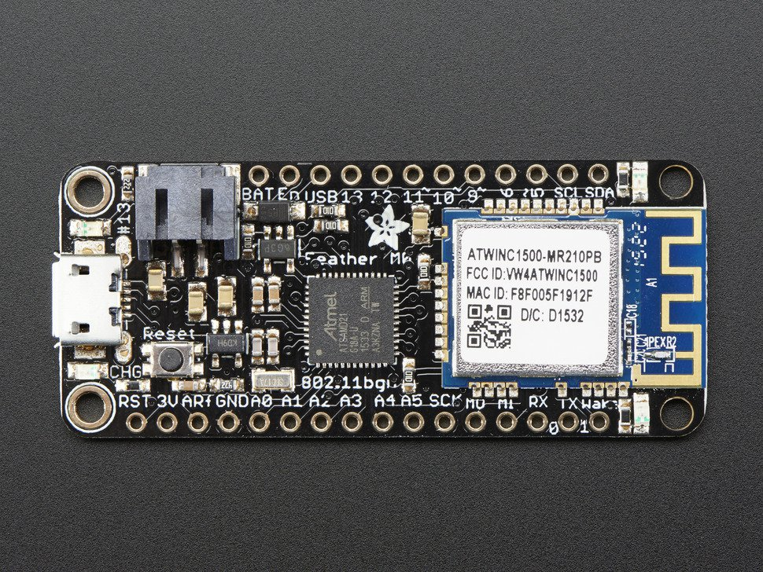
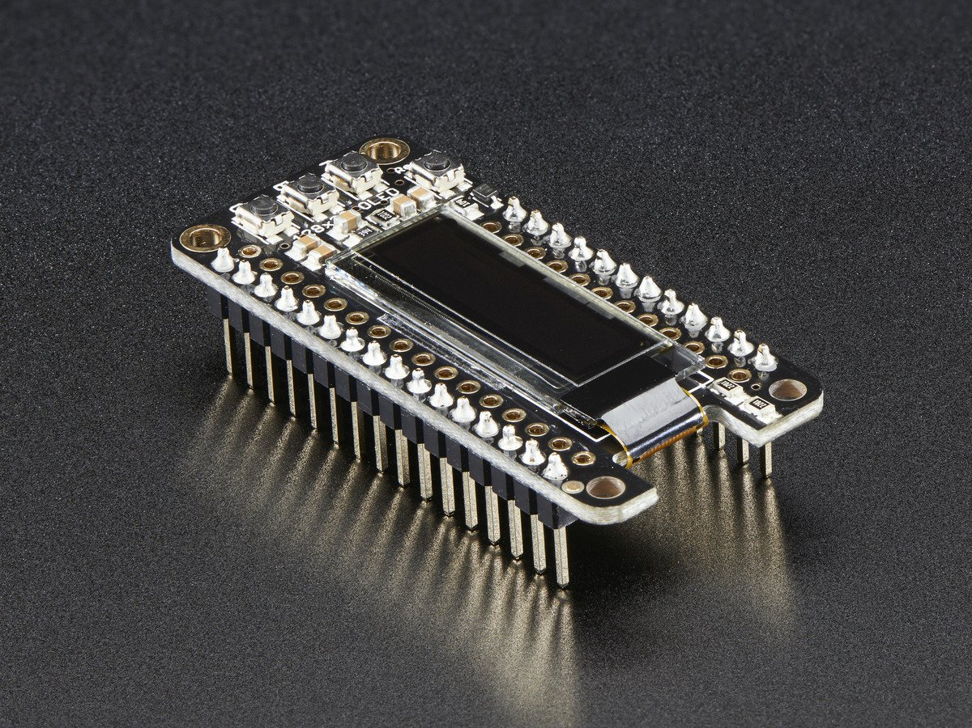
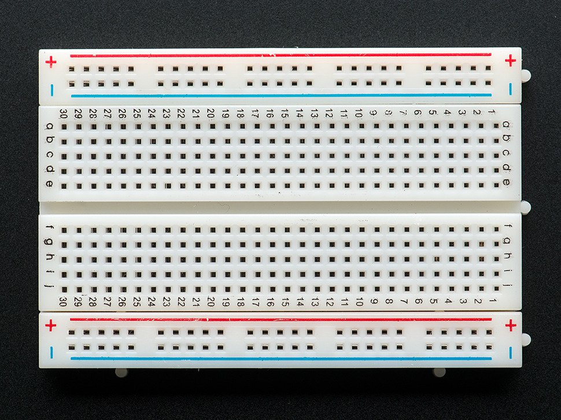
Hardware
What we’re using:
Adafruit Feather M0 FeatherWing OLED Breadboard
Notes:
Breadboard is actually optional, I like to have it because it stabilizes the microcontroller by giving it a larger support base

Slide 17
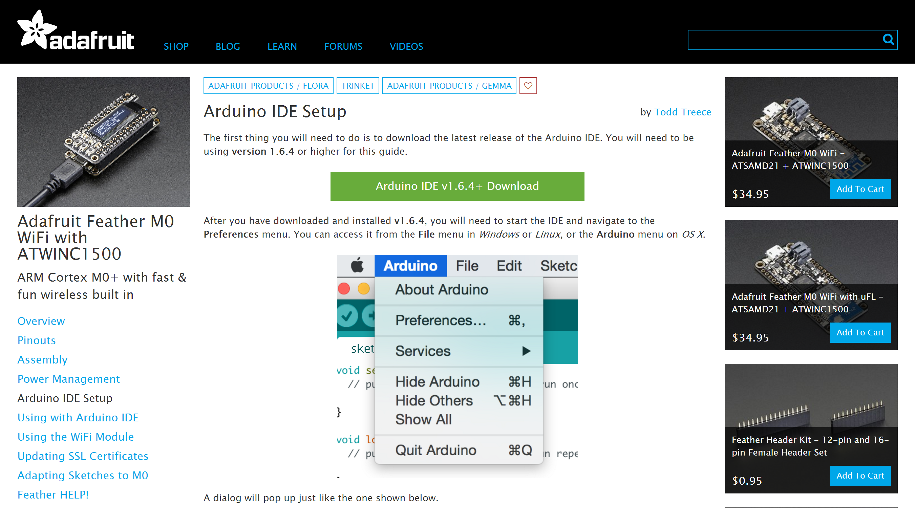

Getting started & set up
https://learn.adafruit.com/adafruit-feather-m0-wifi-atwinc1500/setup
Notes:
You’ll need the Arduino IDE installed (should be real fast, if you don’t already have it) Head over to the link, or google all the keywords in that link - adafruit m0 wifi atwinc, So I’ll give you guys the link to this, but I actually want you to try and work through the process yourselves- I’ll be around to help but the process of actually doing this is the actual

Slide 18
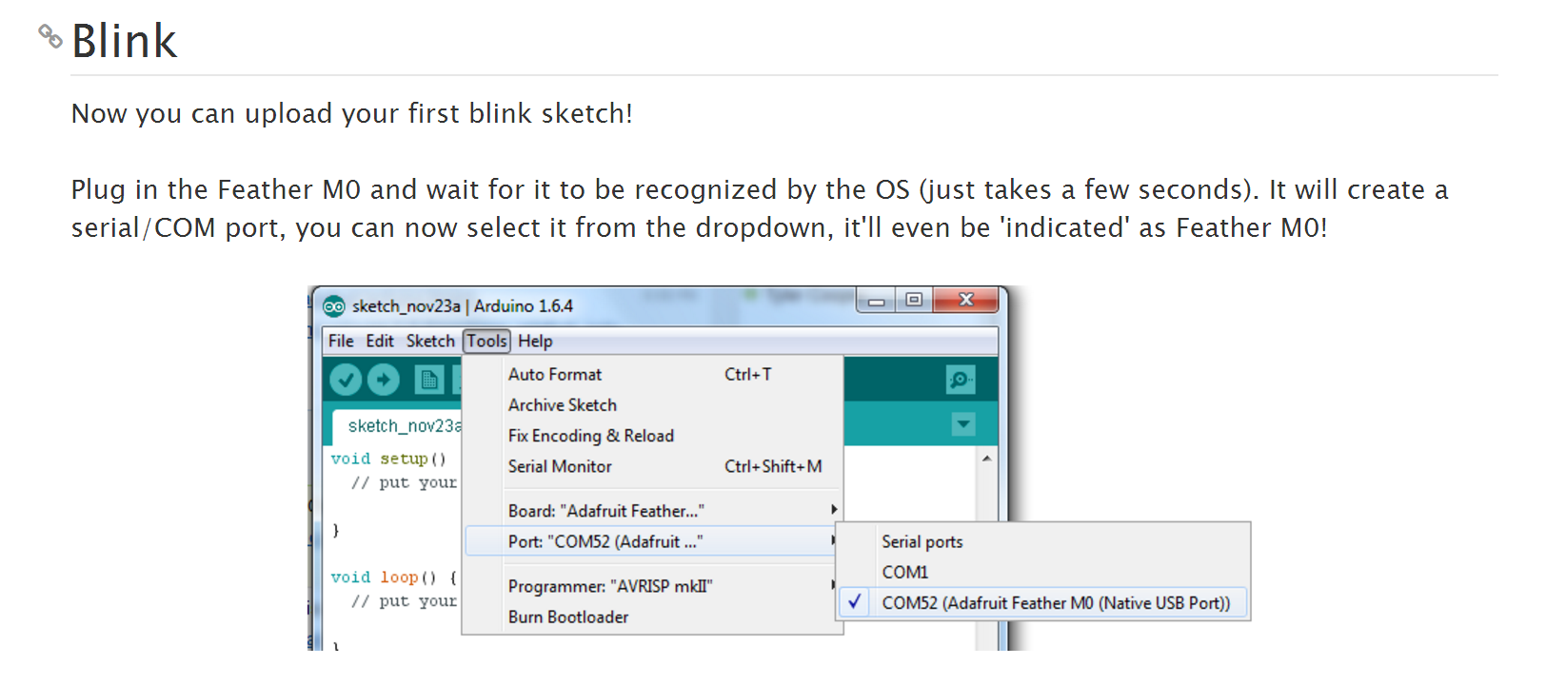
Blink test part 1
Notes:
Whenever programming a new board, make sure to select the specific board type and the port
COM52 in this case just refers to the USB port on your computer that is hooked up to the feather

Slide 19
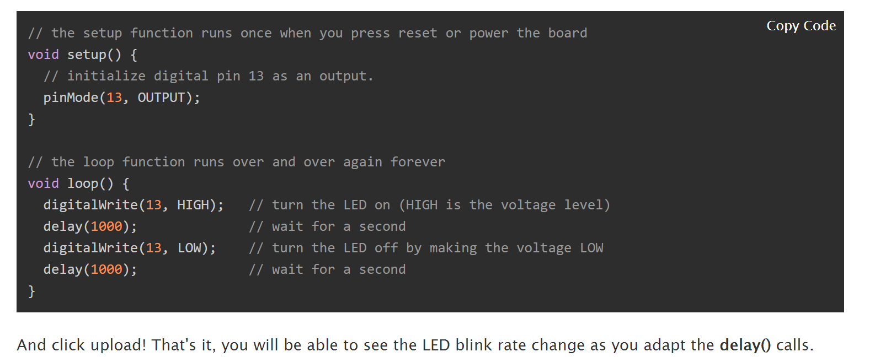
Blink Test- Checking your hardware
Notes:
In this case, I can guarantee that the code is flawless, so if you’re having problems, it means that there’s something wrong with your setup, or the board is faulty, which goes back to the flow chart from a few slides ago

Slide 20
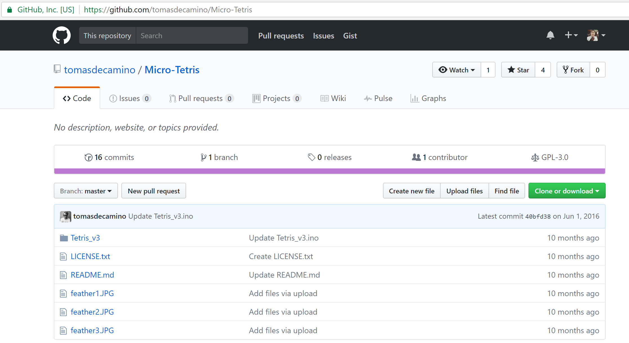
GitHub: An open source playground
Notes:
Time for Tetris- this isn’t a true Tetris clone, but it’s pretty good for something the size of a usb

Slide 21
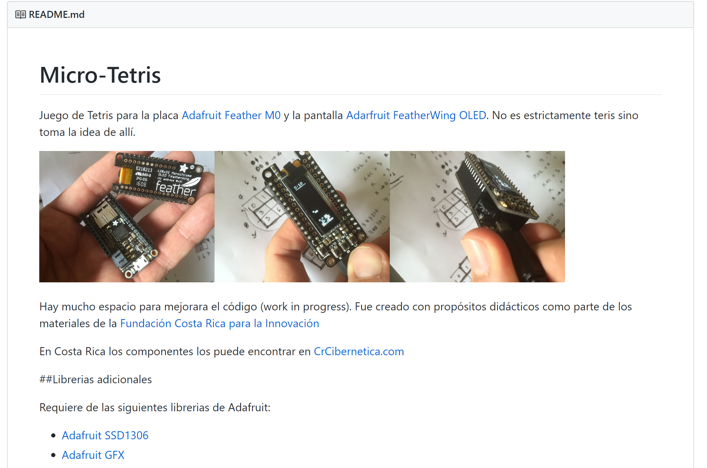
Downloading the required libraries
Notes:
Idk if you can see, but it says “require the following adafruit libraries” , so click and DL em
Libraries TLDR; people write code, zip them into folders, you get to use their code on your own projects The nifty thing about adafruit libraries, is that they come with examples- (this is where you can find it) – try running some example code from the GFX library and see if anything happens. -> compile to see if theres any errors, and then upload

Slide 22
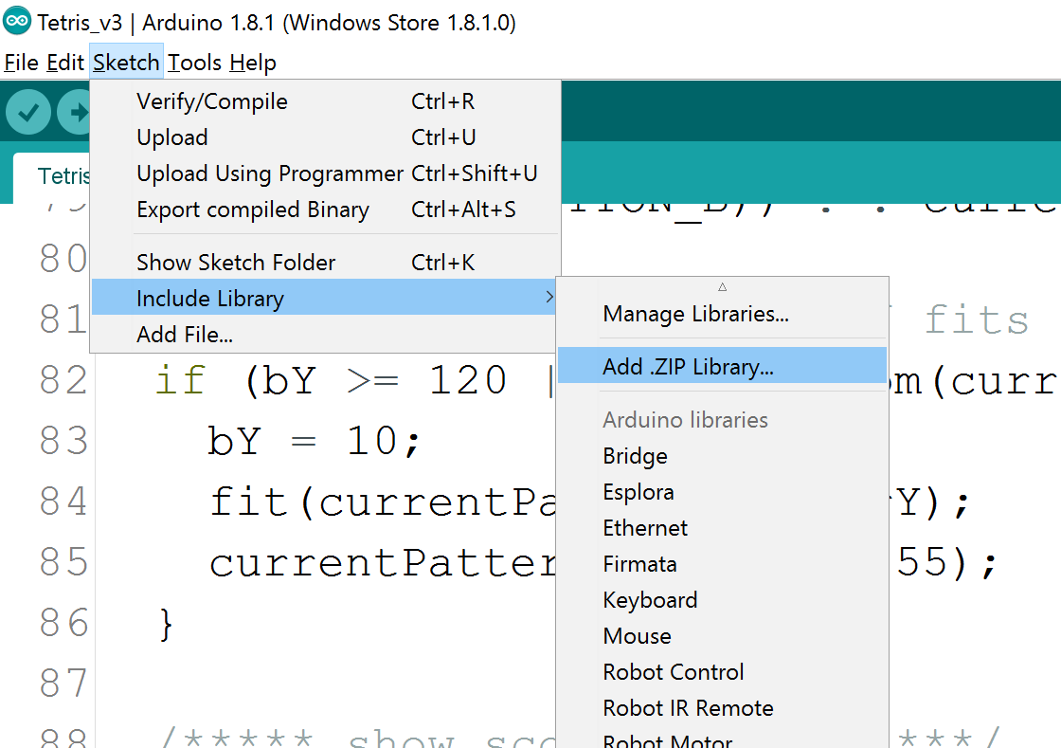
Including libraries in IDE

Slide 23
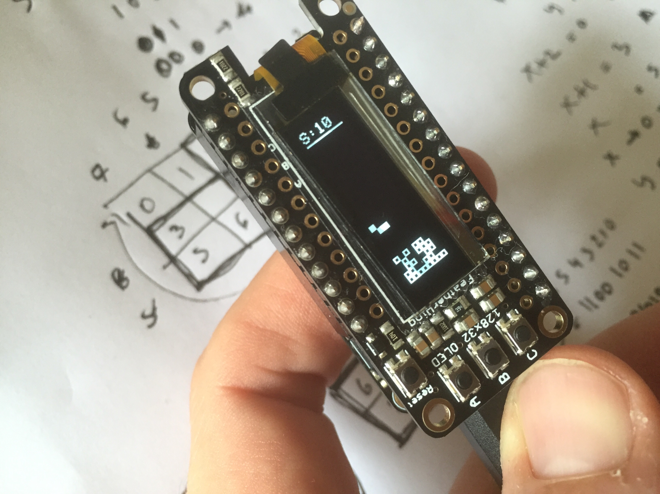
Implementing
Notes:
Hopefully you have something that looks like this
So now you know your hardware works (I hope, reiterate the flowchart), the next step (if you’re not familiar with these libraries or the code, and you don’t want to comb through thousands of lines to figure it out, is to find an example project that makes it all work).

Slide 24

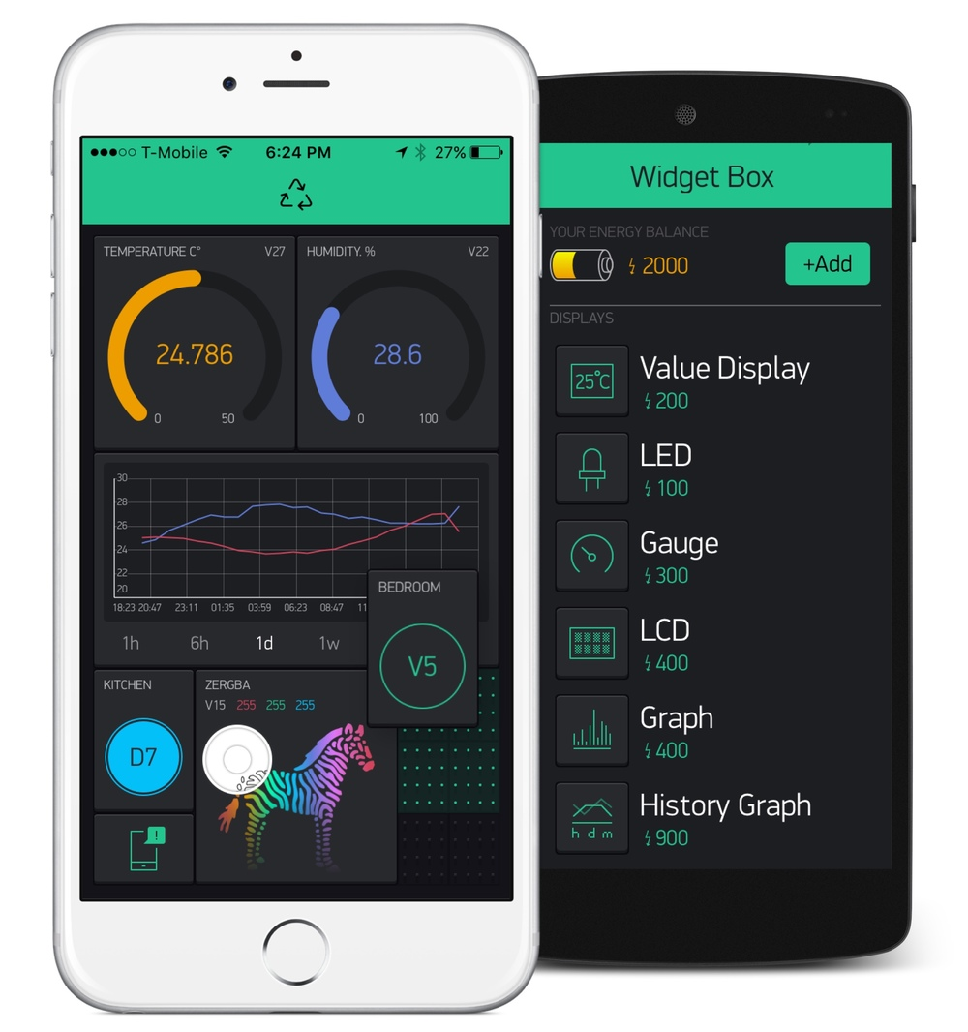
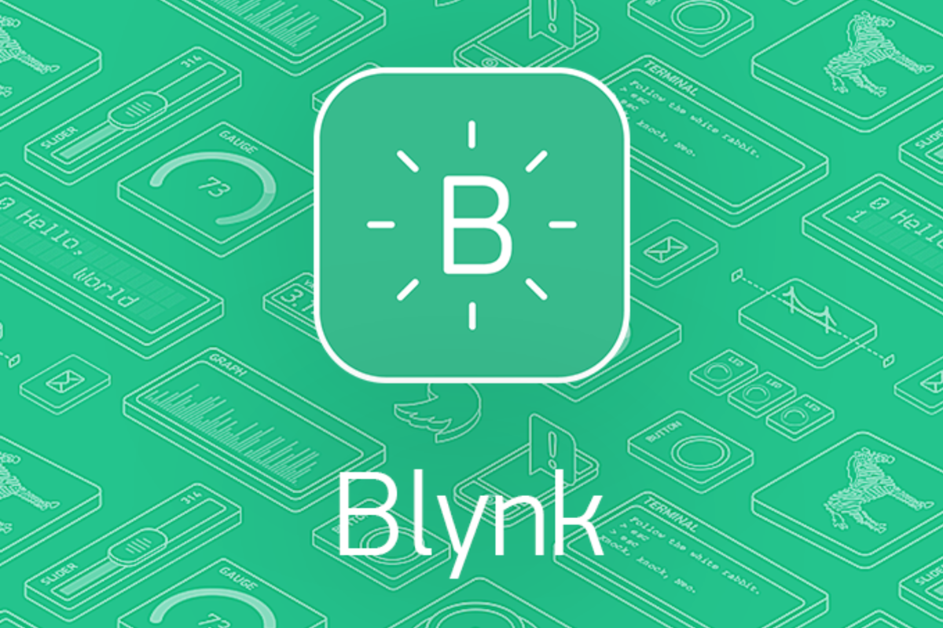

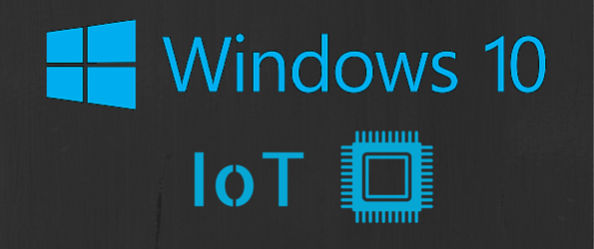
More IoT Resources Here

Slide 25




Shout outs and shameless plugs
Facebook @pittdesignhub
Facebook
@groups/284974235229198/
Or search “Microsoft at Pitt”
Facebook @pittmakerspace
Notes:
Also, if you’re interested in helping run or develop workshops for next year, come talk to me.

